Slide 1

Internet of Things: Multimedia Technologies
Harinath Garudadri and Ganz Chockalingam
Qualcomm Institute of Calit2
University of California, San Diego
Notes:
‹#›

Slide 2

Module Introduction
Lesson 1 – Multimedia Processing
Lesson 2 – Novel Sensing

Slide 3
Lesson 1
Multimedia Processing

Slide 4
Lesson 1 | Multimedia Processing
1 – A Generic Model
2 – Audio Processing
3 – Image Processing
4 – Video Processing
5 – Quality Evaluation

Slide 5
1 - A Generic Model

Slide 6
Multimedia data rates and Internet services
1 | A Generic Model
Wideband Audio → 16 kHz * 14 bits/sample = 224 kbps
CD Audio → 44.1 kHz * 16 bits/sample * 2 channels = 1.41 Mbps
Still Images → 1024x1024 image * 8 bits each for R, G and B = 3.14 MBytes
Raw Video → 1280x720 * 24 bits/pixel @ 24 fps = 530 Mbps
These rates are not compatible with the Internet services. We need to compress data.

Slide 7
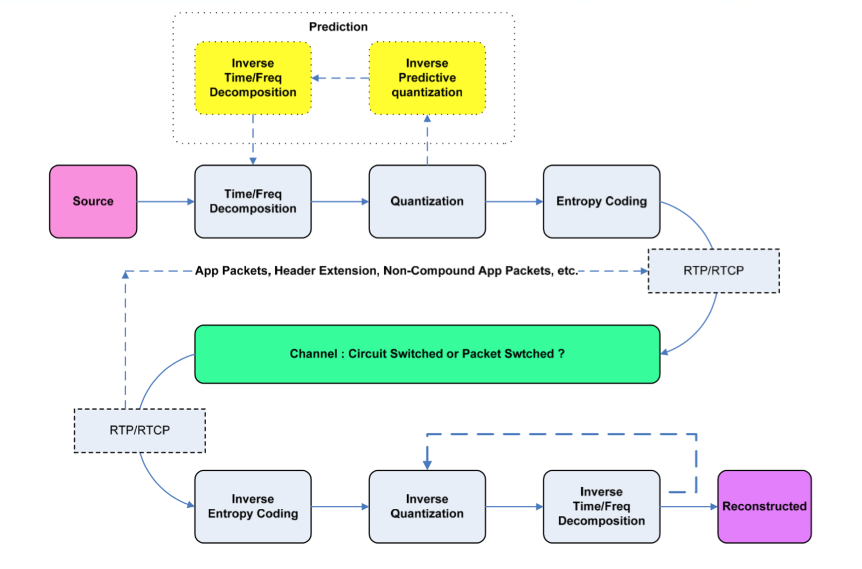
1 | A Generic Model
A Generic Compression Block Diagram

Slide 8
The Spirit of Processing at Encoder
1 | A Generic Model
Time-Frequency Decomposition
Identify Statistical Redundancy in signals
Exploit Perceptual Irrelevancy – requires prior knowledge
Quantization
Lossy bitrate reduction – fewer bits to less relevant components
Entropy Coding
Loss-less bitrate reduction – fewer bits to frequent patterns

Slide 9
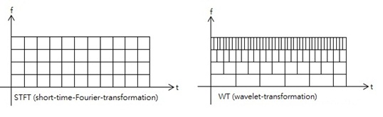
Time-Frequency Decomposition
1 | A Generic Model
Short-time Fourier Transform https://en.wikipedia.org/wiki/Short-time_Fourier_transform
Gabor Transform https://en.wikipedia.org/wiki/Gabor_transform
Wavelet Transform https://en.wikipedia.org/wiki/Wavelet_transform
Modified Discrete Cosine Transform https://en.wikipedia.org/wiki/Modified_discrete_cosine_transform

Slide 10
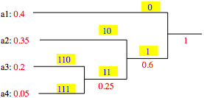
Entropy Coding
1 | A Generic Model
Huffman Coding https://en.wikipedia.org/wiki/Huffman_coding
Arithmetic coding https://en.wikipedia.org/wiki/Arithmetic_coding
Symbol | Code
a1 | 0
a2 | 10
a3 | 110
a4 | 111

Slide 11
2 - Audio Processing

Slide 12
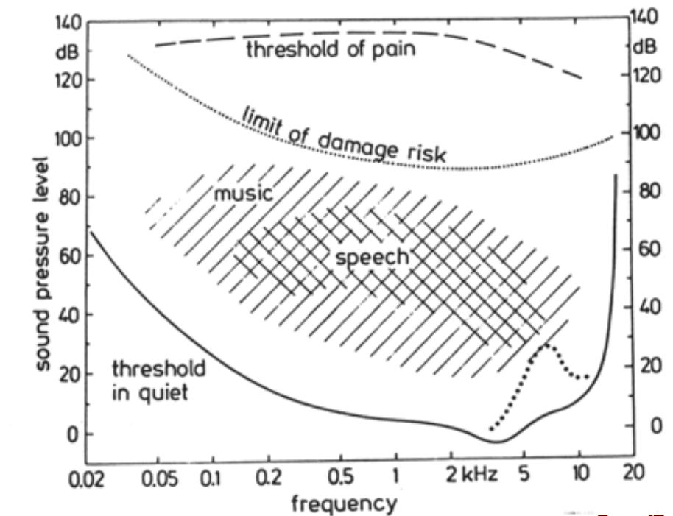
2 | Audio Processing
Fastl and Zwicker, “Psychoacoustics – Facts and Models”, 3rd edition 2007

Slide 13

The Miracle 13dB demo (Brandenburg and Jim Johnston, ‘90)
2 | Audio Processing
100 dB SNR ➔ Noise is 100,000 times below the signal
13 dB SNR ➔ Noise is 20 times below the signal
Original Signal
Original + White noise @ -13 dB
Original + Shaped noise @ -13 dB
Difference of A and C

Slide 14
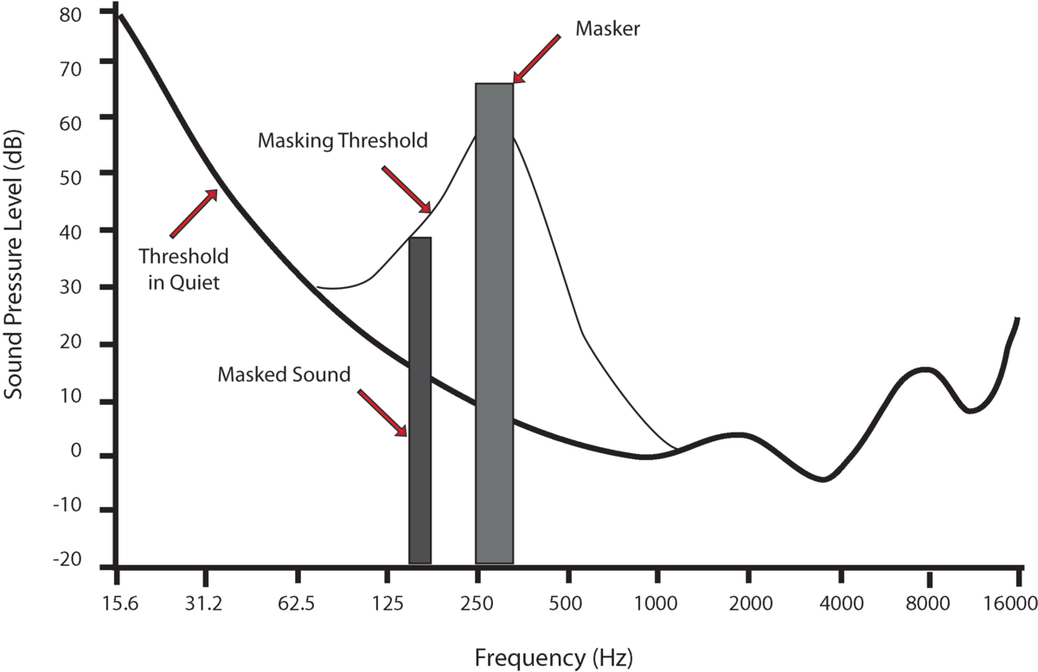
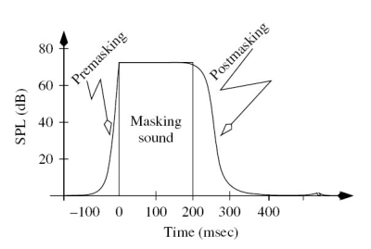
2 | Audio Processing
Fastl and Zwicker, “Psychoacoustics – Facts and Models”, 3rd edition 2007

Slide 15
2 | Audio Processing
High Resolution
T-F decomposition
Psychoacoustic Model

Slide 16
3 - Image Processing

Slide 17
Still Images
3 | Image Processing
JPEG – Joint Photographic Experts Group, a Working Group (WG) in ISO/IEC
* International Standardization Organization (ISO)
* International Electrotechnical Commission (IEC)
For a good review https://en.wikipedia.org/wiki/JPEG

Slide 18

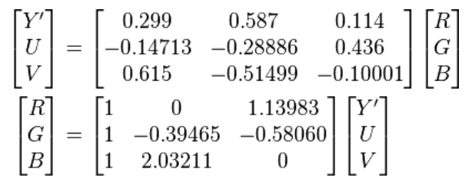
3 | Image Processing

Slide 19

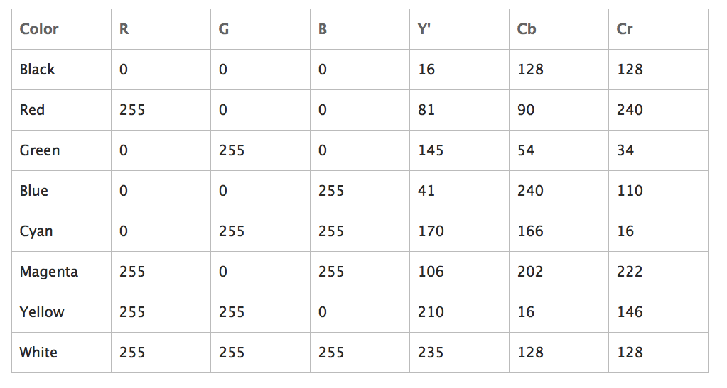
3 | Image Processing
YUV is same as Y’C_{B}C_{R};
Y’ (luma) is gamma corrected Luminance, but ‘ is not usually used.
https://msdn.microsoft.com/en-us/library/windows/desktop/bb530104(v=vs.85).aspx

Slide 20

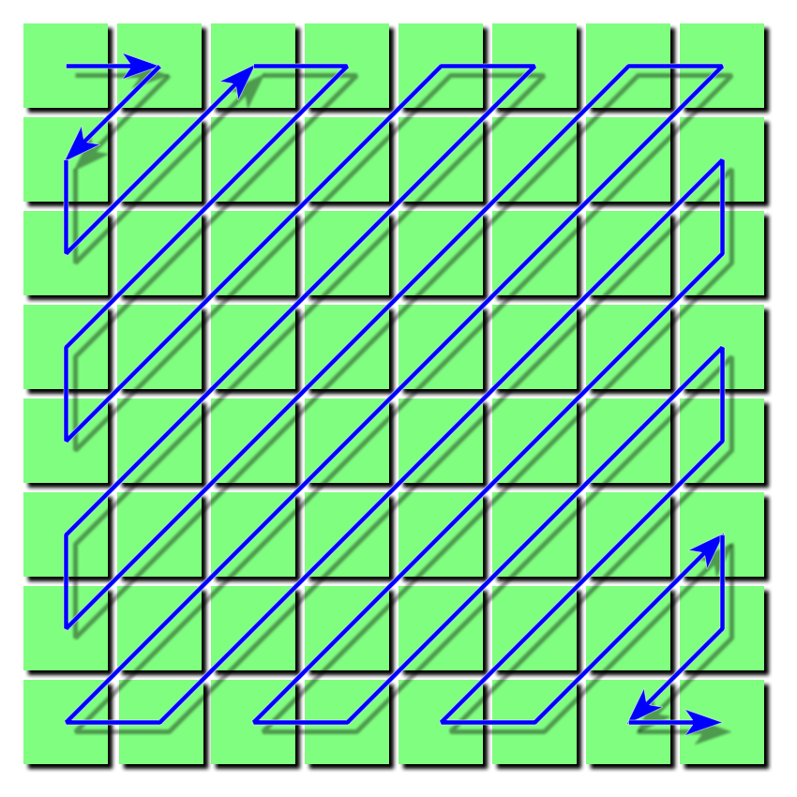
3 | Image Processing
Visualization of 8x8 DCT basis functions
The zig-zag scanning pattern in JPEG

Slide 21
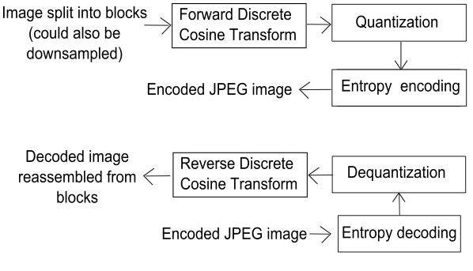
3 | Image Processing

Slide 22
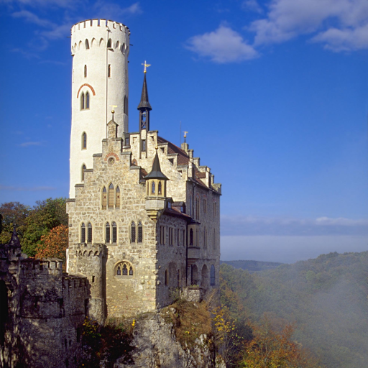
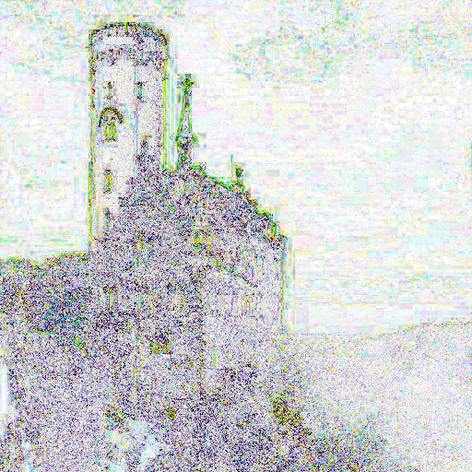
3 | Image Processing

Slide 23
4 - Video Processing

Slide 24
4 | Video Processing
Motion Estimation
Predicted Frame (motion compensated)
Motion information
(P and B frames)

Slide 25
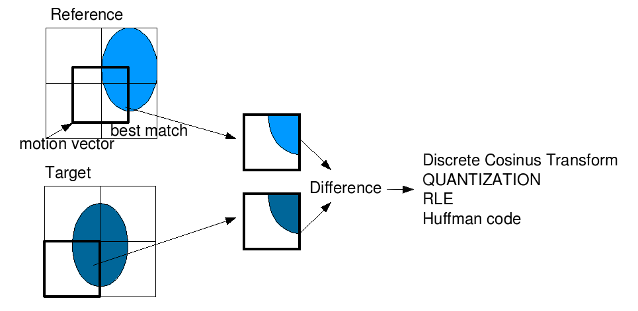
4 | Video Processing
http://web.stanford.edu/class/ee398a/handouts/lectures/EE398a_MotionEstimation_2012.pdf

Slide 26
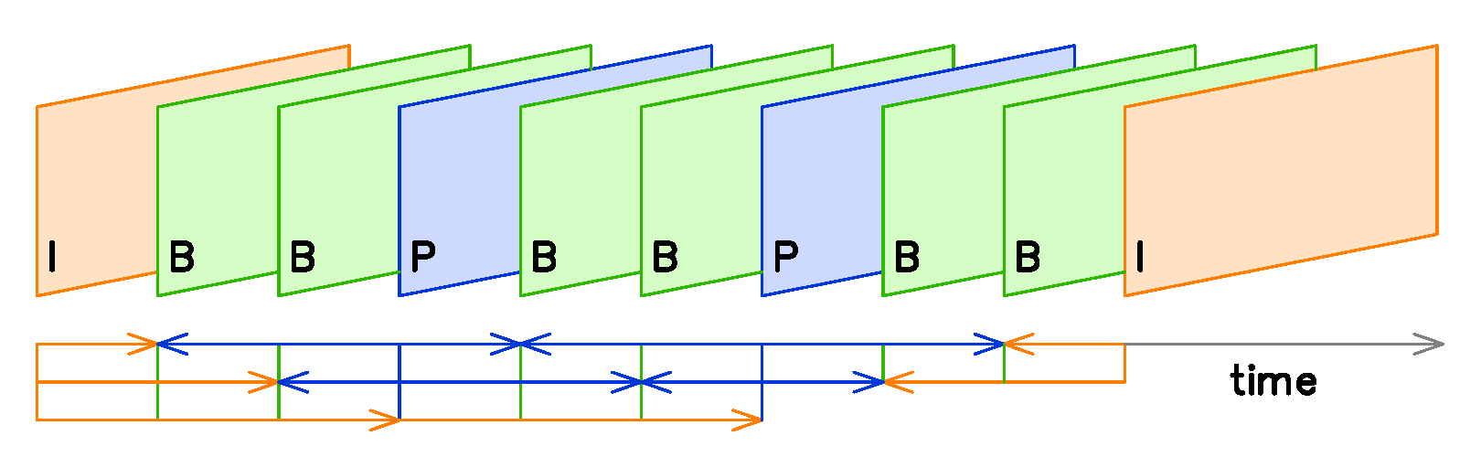
4 | Video Processing

Slide 27
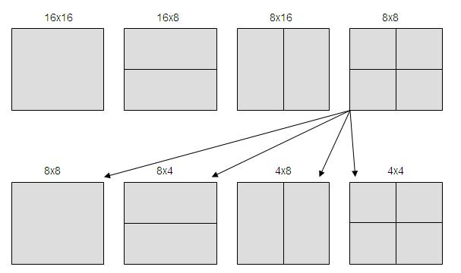
4 | Video Processing

Slide 28
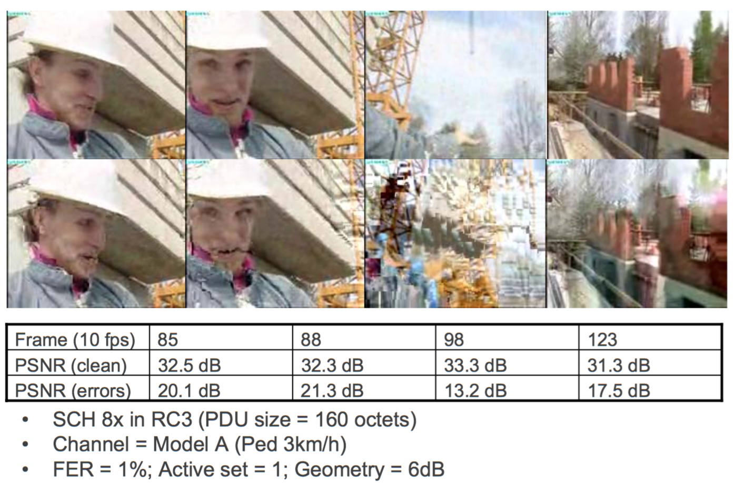
4 | Video Processing

Slide 29
5 - Quality Evaluation

Slide 30
Multimedia data rates and Internet services
5 | Quality Evaluation
Wideband Audio → 16 kHz * 14 bits/sample = 224 kbps → 8 – 12 kbps
CD Audio → 44.1 kHz * 16 bits/sample * 2 channels = 1.41 Mbps → 64 – 256 kbps
Still Images → 1024x1024 image * 8 bits each for R, G and B = 3.14 Mbytes → 30 – 300 MBytes
Raw Video → 1280x720 * 24 bits/pixel @ 24 fps = 530 Mbps → 768 – 1536 kbps
The exact output size depends on the content and encoder settings (for the desired quality)

Slide 31
Subjective Evaluation of Quality
5 | Quality Evaluation
ABX Test
A is original; B is encoded and decoded
Is X close to A or B?
ABC/HR Test
A and B are original and encoded/decoded in random order
C is always original;
Identify processed signal and assign subjective quality score
MUSHRA
MUltiple Stimuli with Hidden Reference and Anchor
Reference is known; tests include a hidden version of reference and one or more anchors of known (assessed) quality

Slide 32
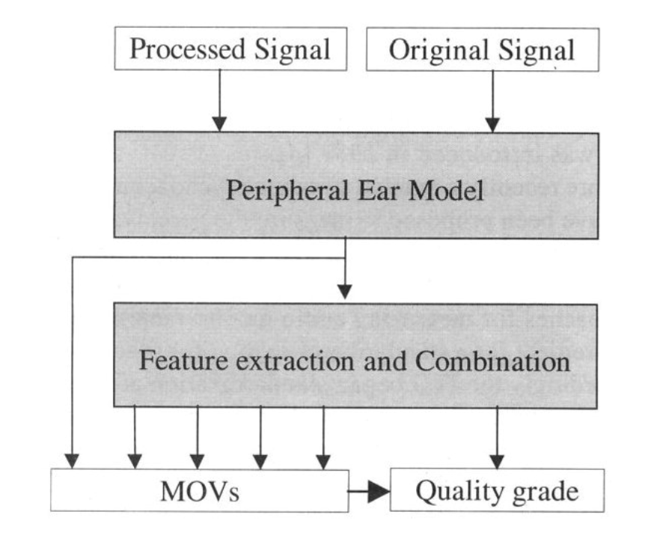
Objective Evaluation of Quality
5 | Quality Evaluation
PEAQ – Perceptual Evaluation of Audio Quality

Slide 33
Lesson 2
Novel Sensing

Slide 34
Lesson 2 | Novel Sensing
Lesson 1 – Pixel Camera
Lesson 2 – Fall Risk Assessment
Lesson 3 – An Objective Balance Test

Slide 35
1 - Pixel Camera

Slide 36
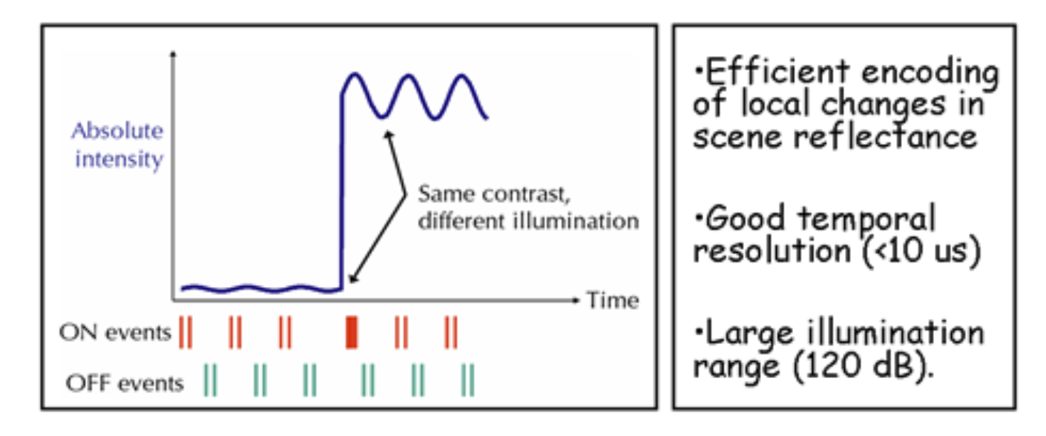
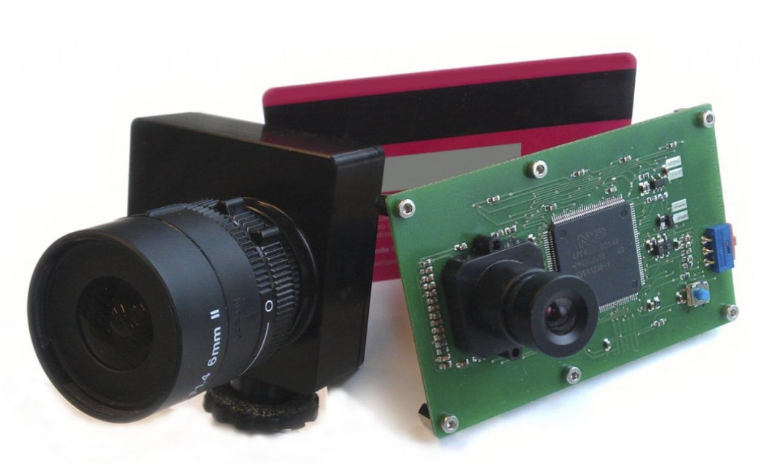
1 | Pixel Camera
http://inilabs.com/products/dynamic-vision-sensors/

Slide 37
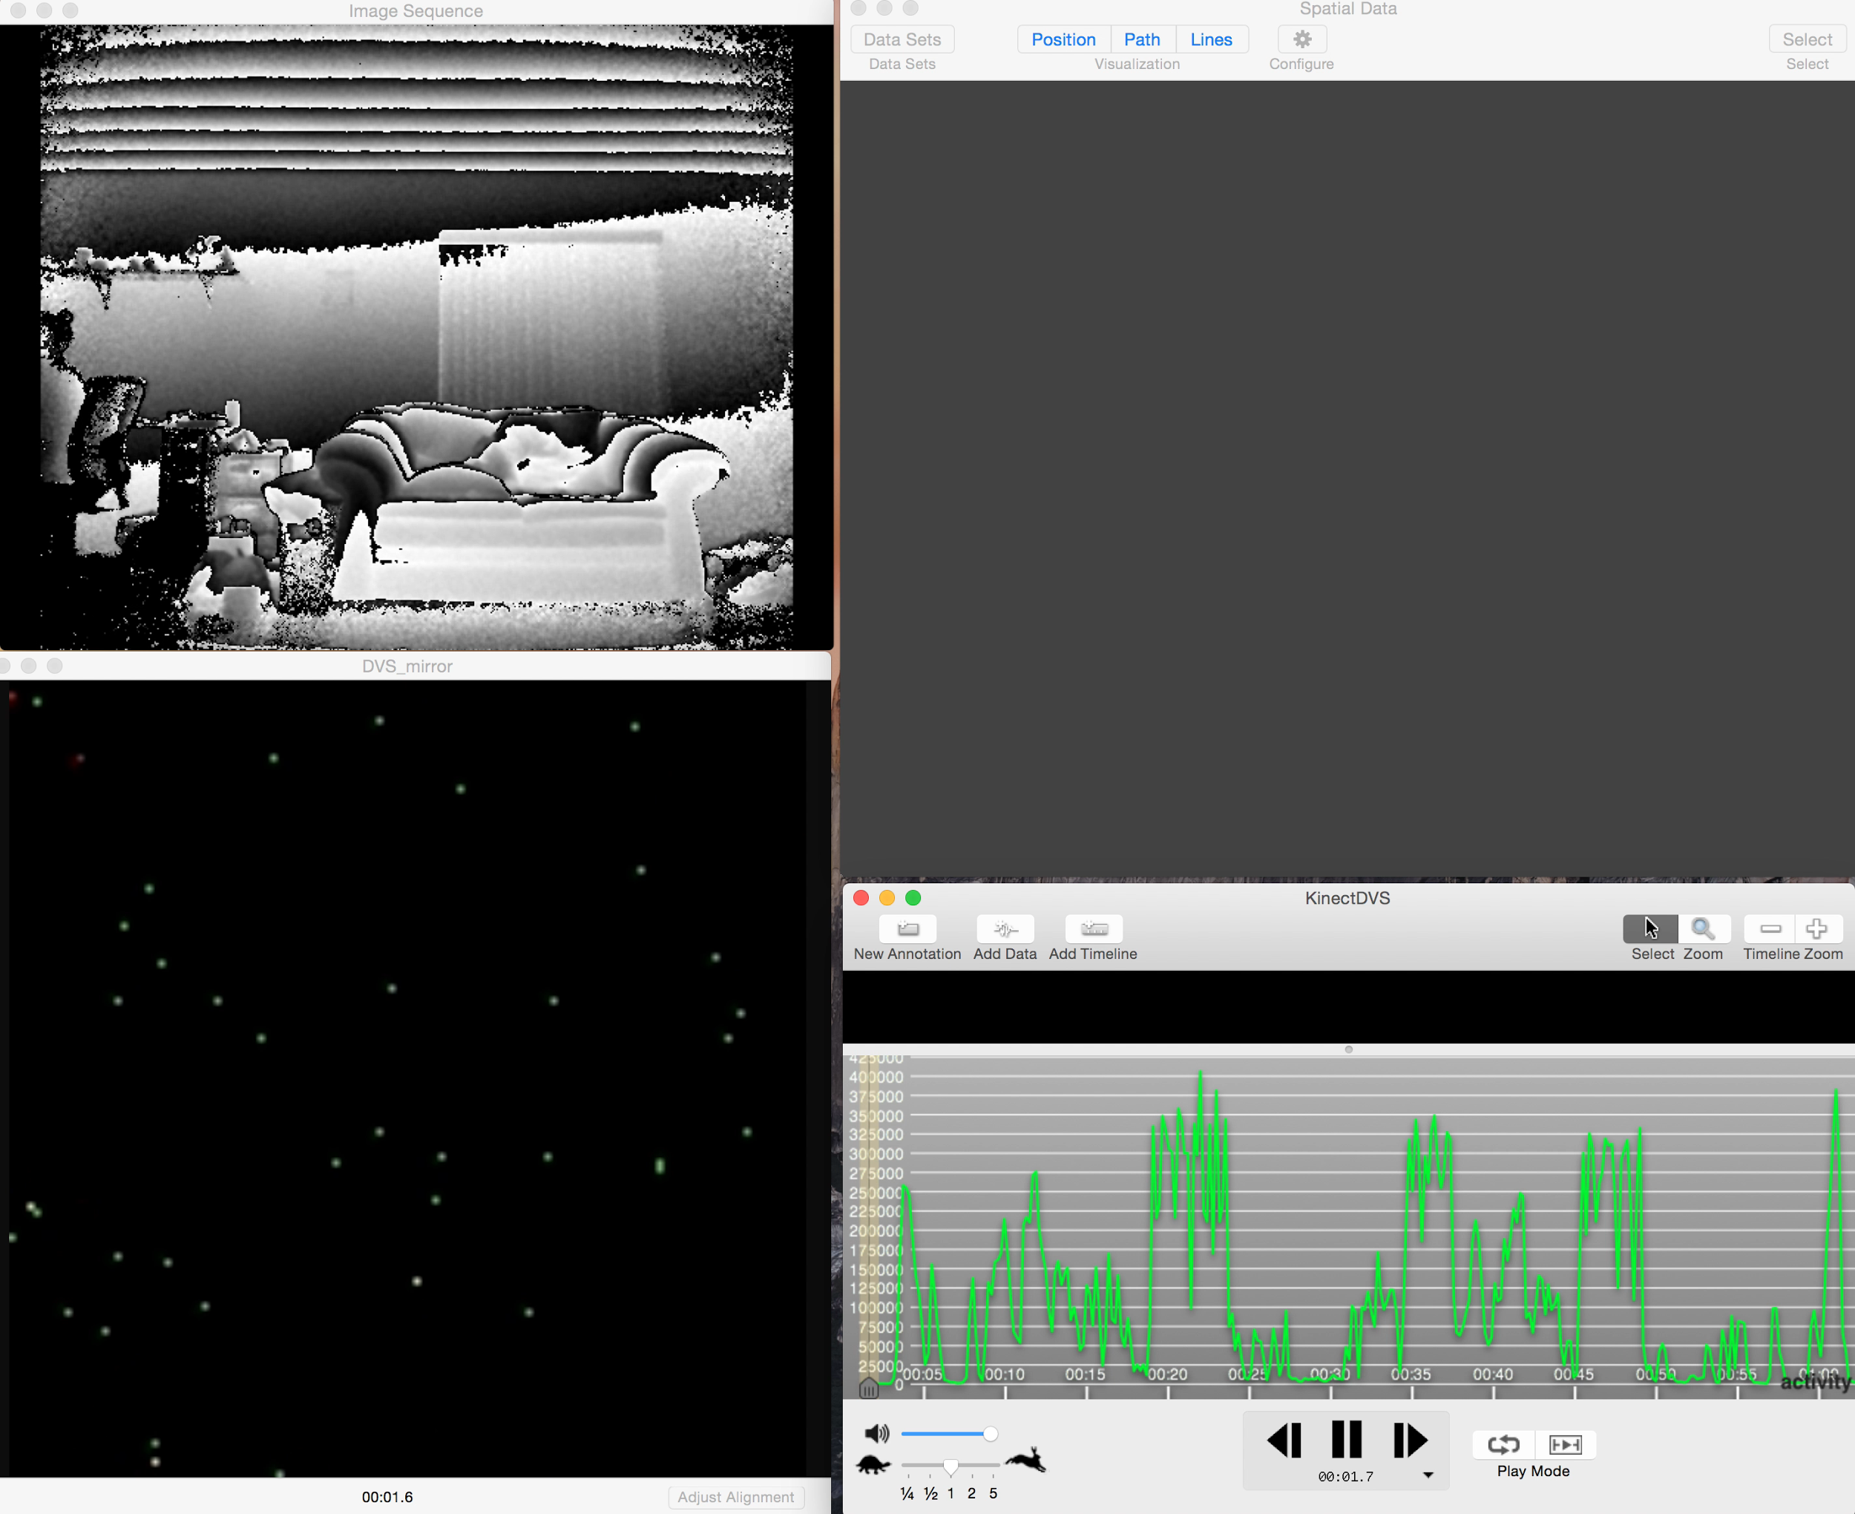
1 | Pixel Camera
VIDEO! PLEASE
‹#›

Slide 38
2 - Fall Risk Assessment

Slide 39
CDC Estimates for Cost of Falls in US
2 | Fall Risk Assessment
$34 Billion (2013)
$55 Billion (2020)

Slide 40

Inability to Maintain Postural Balance α Greater Risk of Falls
2 | Fall Risk Assessment
3/26/14
‹#›

Slide 41
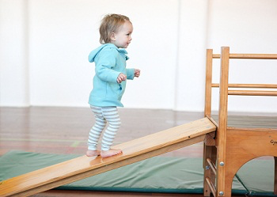
2 | Fall Risk Assessment

Slide 42
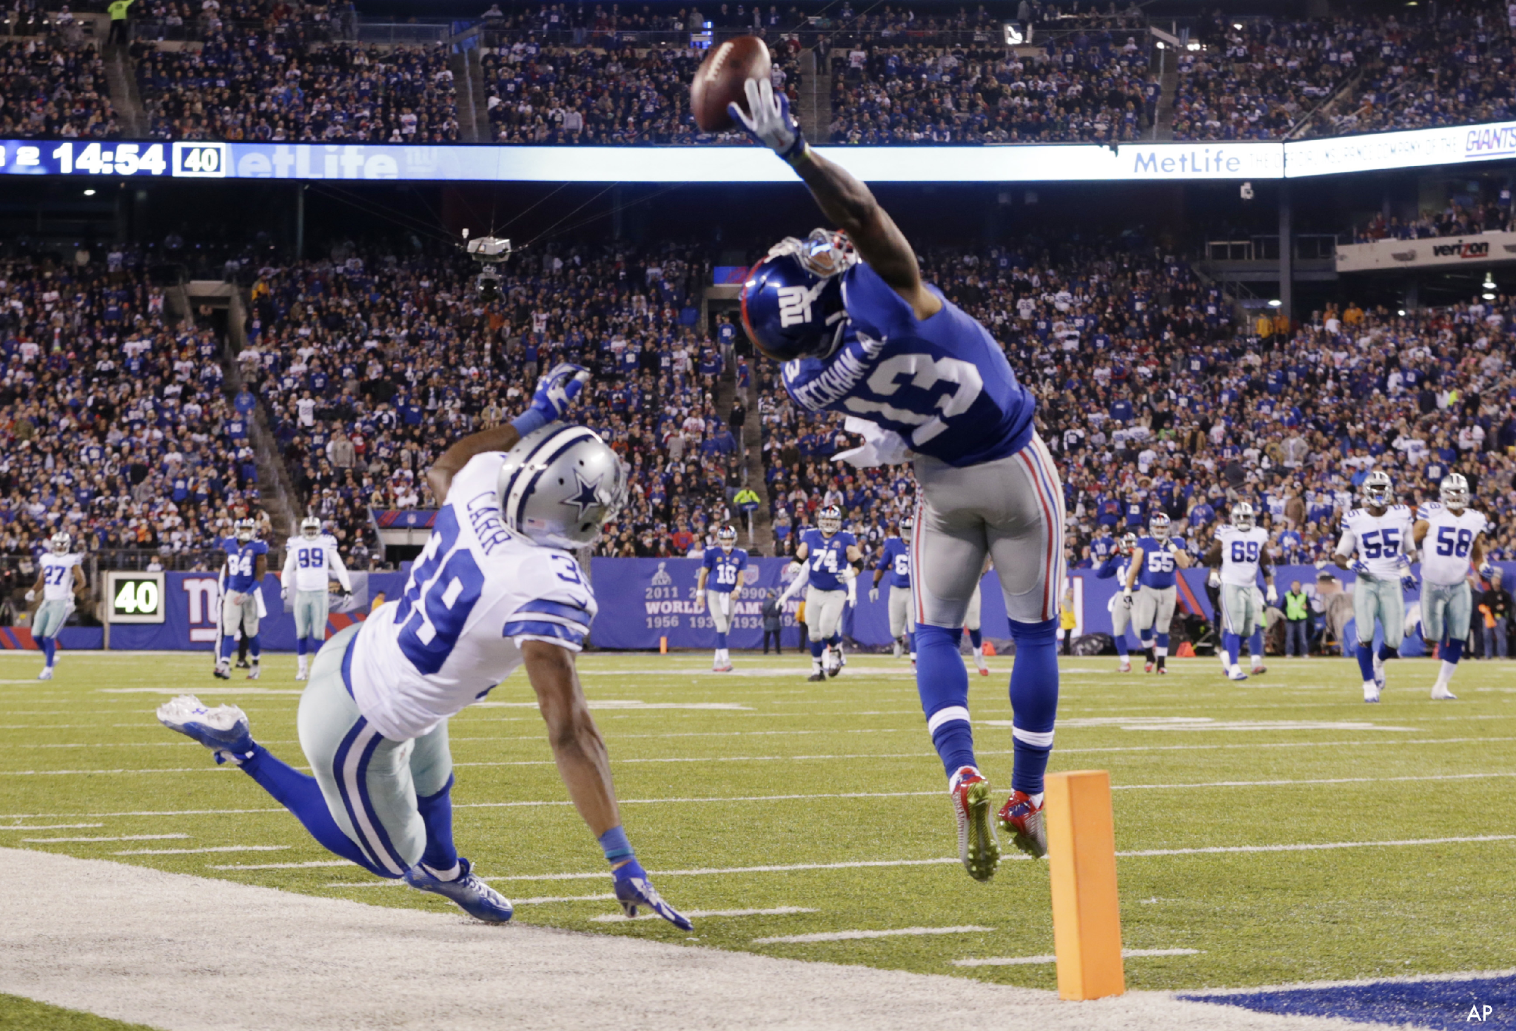
2 | Fall Risk Assessment

Slide 43
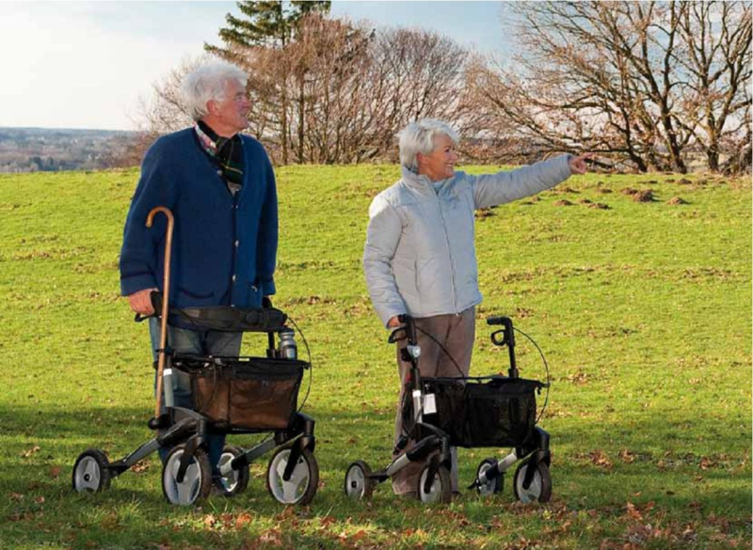
2 | Fall Risk Assessment

Slide 44
3 - An Objective Balance Test

Slide 45
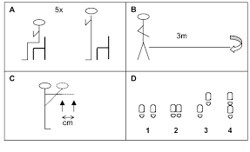

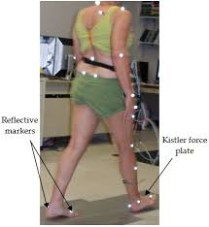
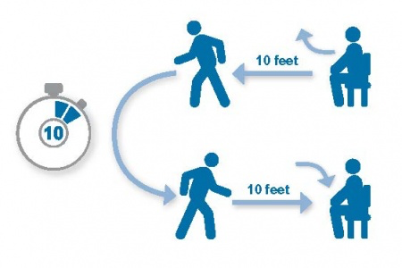
Current “Gold” Standards
3 | An Objective Balance Test
Interview and Observational
Subjective and non-repeatable
Gait Labs and Force Plates
Objective, but expensive

Slide 46
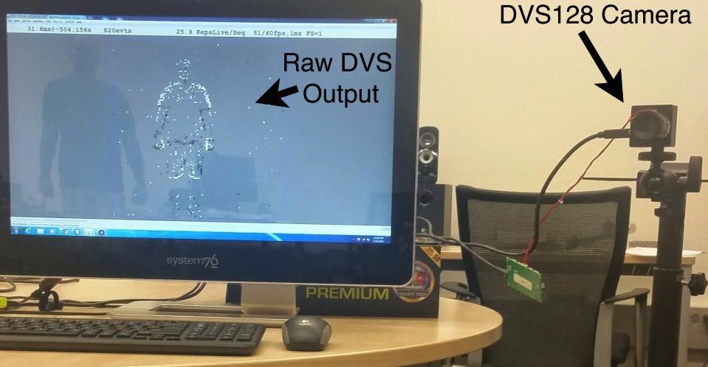
Camera Based Assessment
3 | An Objective Balance Test
Integrates with current work flows
Dynamic Vision Sensor – pixel changes at 1 μs
Considered similar to visual cortex V1

Slide 47
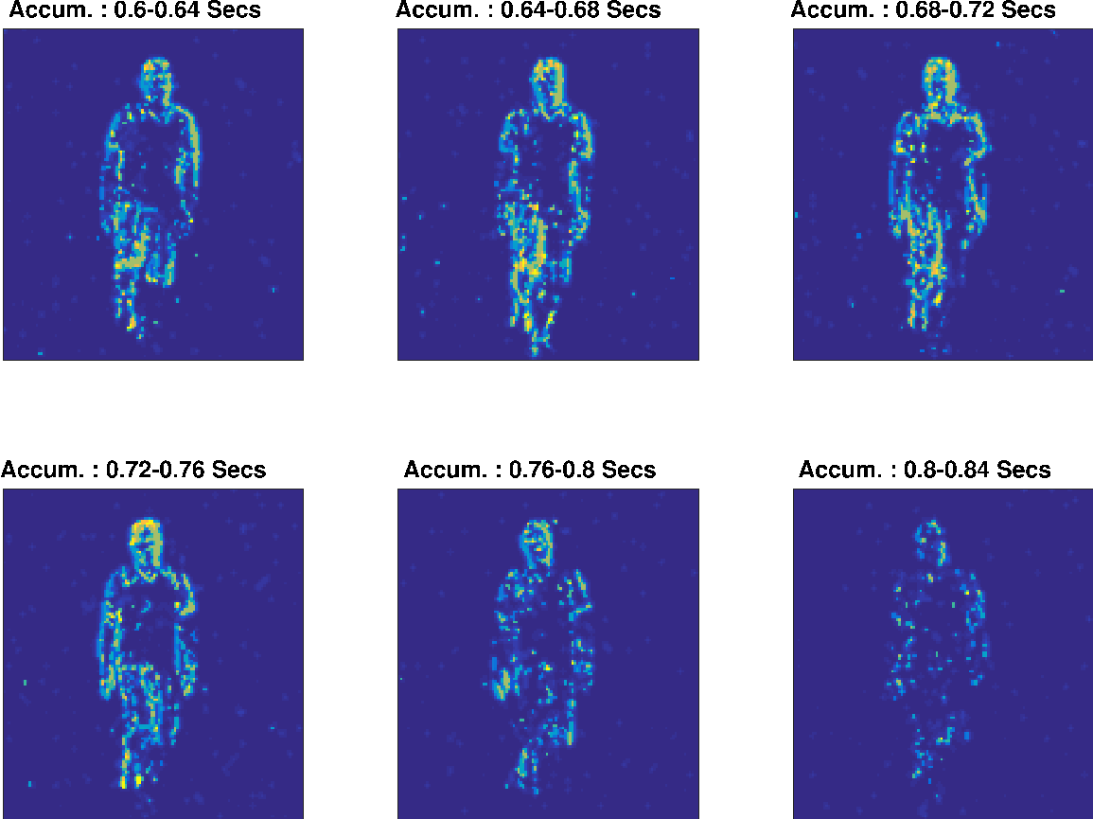
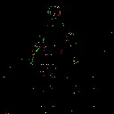
Off Body Sensing: Dynamic Vision Sensor (DVS) Camera
3 | An Objective Balance Test
VIDEO! PLEASE
Figure 2: Images from Dynamic Vision Sensor system during a balance test.
A.Nalci et. al. “A Computer Vision Based Candidate for Functional Balance Test”, IEEE EMBC, Aug. 2015, Milan, Italy.

Slide 48
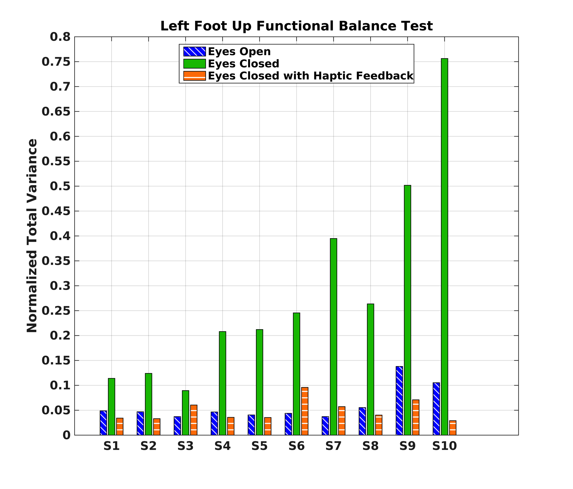
3 | An Objective Balance Test

Slide 49
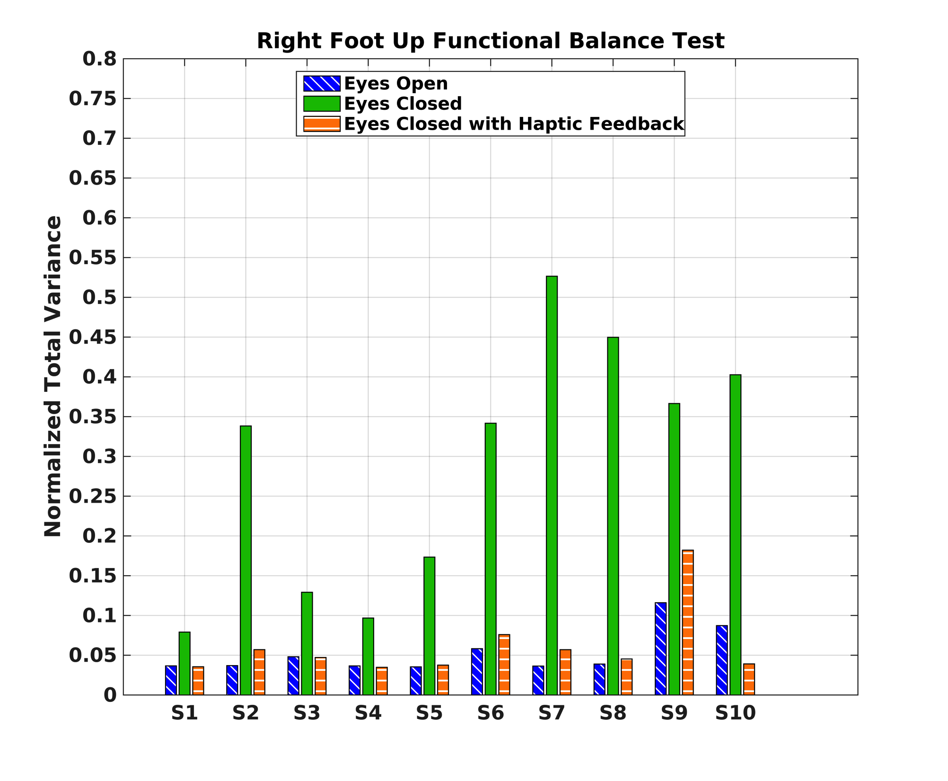
3 | An Objective Balance Test

Slide 50
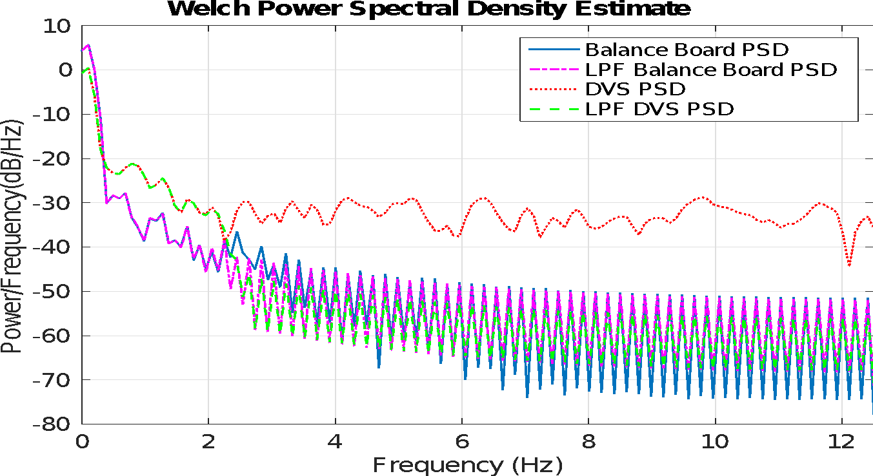
3 | An Objective Balance Test

Slide 51
5 | Multimedia Technologies
Further Study

Slide 52
Back up slides

